Slide 1
15-441 Computer Networking
Lecture 4 - Physical Layer, Link Layer Basics, Switching

Slide 2
Links
How to make computers talk across a wire
How to share the wire
Notes:
Simple first step ---

Slide 3
From Signals to Packets
Analog Signal
“Digital” Signal
Bit Stream
0 0 1 0 1 1 1 0 0 0 1
Packets
0100010101011100101010101011101110000001111010101110101010101101011010111001
Header/Body
Header/Body
Header/Body
Packet
Transmission
Sender
Receiver

Slide 4

Link Layer: Implementation
Implemented in “adapter”
  E.g., PCMCIA card, Ethernet card
  Typically includes: RAM, DSP chips, host bus interface, and link interface
M
application
transport
network
link
physical
network
link
physical
H
t
M
H
H
M
data link
protocol
n
t
H
H
H
H
H
H
M
l
n
t
M
l
n
t
frame
phys. link
adapter card

Slide 5
Outline
Physical media is analog
  Modulation – signals to bits
Bit stream vs. packets
  Framing – how to make packets
Corruption
  Error detection & recovery
Sharing
  Media access

Slide 6
Modulation
Sender changes the nature of the signal in a way that the receiver can recognize.
  Similar to radio: AM or FM
Digital transmission: encodes the values 0 or 1 in the signal.
  It is also possible to encode multi-valued symbols
Amplitude modulation: change the strength of the signal, typically between on and off.
  Sender and receiver agree on a “rate”
  On means 1, Off means 0
Similar: frequency or phase modulation.
Can also combine method modulation types.

Slide 7
Amplitude and Frequency
Modulation
0 0 1 1 0 0 1 1 0 0 0 1 1 1 0 0 0 1 1 0 0 0 1 1 1 0
0 1 1 0 1 1 0 0 0 1

Slide 8
Modulation
Non-Return to Zero (NRZ)
  Used by Synchronous Optical Network (SONET)
  1=high signal, 0=low signal
  Long sequence of same bit cause difficulty
    DC bias hard to detect – low and high detected by difference from average voltage
    Clock recovery difficult
Notes:
Draw 0 1 0 1 = LHLH

Slide 9
Clock Recovery
When to sample voltage?
Synchronized sender and receiver clocks
Need easily detectible event at both ends
  Signal transitions help resync sender and receiver
  Need frequent transitions to prevent clock skew
  SONET XOR’s bit sequence to ensure frequent transitions

Slide 10
Modulation
Non-Return to Zero Inverted (NRZI)
  1=inversion of current value, 0=same value
  No problem with string of 1’s
  NRZ-like problem with string of 0’s
Notes:
draw 0 1 0 1 = H HLLH

Slide 11
Modulation
Manchester
  Used by Ethernet
  0=low to high transition, 1=high to low transition
  Transition for every bit simplifies clock recovery
  Not very efficient
    Doubles the number of transitions
    Circuitry must run twice as fast
Notes:
0 1 0 1 = H LH HL LH HL

Slide 12
CORRECTION
Sept 17: Please note the following correction to Manchester encoding. While the book and state that Ethernet uses 0 = first half low and second half high signal, and 1 = first high then low, this is incorrect. The 802.3 specs state that Ethernet encodes 0 as first half clock cycle = high, second half = low and that 1 is the opposite. The basic concept/tradeoffs remain the same. We will accept either on the homework.

Slide 13
Modulation
4b/5b
  Used by FDDI
  Uses 5bits to encode every 4bits
  Encoding ensures no more than 3 consecutive 0’s
  Uses NRZI to encode resulting sequence
  16 data values, 3 “special” illegal values, 6 “extra” values, 7 illegal values
Notes:
0 1 0 1 = 01011 = H HLLHL

Slide 14
Outline
Physical media is analog
  Modulation – signals to bits
Bit stream vs. packets
  Framing – how to make packets
Corruption
  Error detection & recovery
Sharing
  Media access

Slide 15
Framing
Length delimited
  Beginning of frame has length
  Single corrupt length can cause problems
    Must have start of frame character to resynchronize
    Resynchronization can fail if start of frame character is inside packets as well
Notes:
Draw on board

Slide 16
Framing
Byte stuffing
  Special start of frame byte (e.g. 0xFF)
  Special escape byte value (e.g. 0xFE)
  Values actually in text are replaced (e.g. 0xFF by 0xFEFF and 0xFE by 0xFEFE)
  Worst case – can double the size of frame
Bit stuffing
  Special bit sequence (0x01111110)
  0 bit stuffed after any 11111 sequence

Slide 17
Clock-Based Framing
Used by SONET
Fixed size frames (810 bytes)
Look for start of frame marker that appears every 810 bytes
Will eventually sync up

Slide 18
Consistent Overhead Byte Stuffing
Run length encoding applied to byte stuffing
Encoding
  Add implied 0 to end of frame
  Each 0 is replaced with (number of bytes to next 0) + 1
  What if no 0 within 255 bytes? – 255 value indicates 254 bytes followed by no zero
  Worst case – no 0’s in packet – 1/254 overhead
  Possible optimization to encode series of 0’s

Slide 19
Outline
Physical media is analog
  Modulation – signals to bits
Bit stream vs. packets
  Framing – how to make packets
Corruption
  Error detection & recovery
Sharing
  Media access

Slide 20

Error Detection
EDC= Error Detection and Correction bits (redundancy)
D = Data protected by error checking, may include header fields
Error detection not 100% reliable!
  Protocol may miss some errors, but rarely
  Larger EDC field yields better detection and correction

Slide 21

Parity Checking
Single Bit Parity:
Detect single bit errors

Slide 22
Error Detection - Checksum
Used by TCP, UDP, IP, etc..
Ones complement sum of all words/shorts/bytes in packet
Simple to implement
Relatively weak detection
  Easily tricked by typical loss patterns

Slide 23
Internet Checksum
Goal: detect “errors” (e.g., flipped bits) in transmitted segment
Sender
Treat segment contents as sequence of 16-bit integers
Checksum: addition (1’s complement sum) of segment contents
Sender puts checksum value into checksum field in header
Receiver
Compute checksum of received segment
Check if computed checksum equals checksum field value:
  NO - error detected
  YES - no error detected. But maybe errors nonethless?

Slide 24
Error Detection – Cyclic Redundancy Check (CRC)
Polynomial code
  Treat packet bits a coefficients of n-bit polynomial
  Choose r+1 bit generator polynomial (well known – chosen in advance)
  Add r bits to packet such that message is divisible by generator polynomial
Better loss detection properties than checksums

Slide 25

Error Detection – CRC
View data bits, D, as a binary number
Choose r+1 bit pattern (generator), G
Goal: choose r CRC bits, R, such that
  <D,R> exactly divisible by G (modulo 2)
  Receiver knows G, divides <D,R> by G. If non-zero remainder: error detected!
  Can detect all burst errors less than r+1 bits
Widely used in practice (ATM, HDCL)

Slide 26

CRC Example
Want:
  D.2r XOR R = nG
equivalently:
  D.2r = nG XOR R
equivalently:
if we divide D.2r by G, want reminder Rb
D.2r
G
R = remainder[ ]

Slide 27
Error Recovery
Two forms of error recovery
  Error Correcting Codes (ECC)
  Automatic Repeat Request (ARQ)
ECC
  Send extra redundant data to help repair losses
ARQ
  Receiver sends acknowledgement (ACK) when it receives packet
  Sender uses ACKs to identify and resend data that was lost

Slide 28

Error Recovery – Error Correcting Codes (ECC)
Two Dimensional Bit Parity:
Detect and correct single bit errors
0
0

Slide 29
Stop and Wait
Simplest ARQ protocol
Send a packet, stop and wait until acknowledgement arrives
Will examine ARQ issues later in semester
Sender
Receiver
Packet
Time
Timeout
ACK

Slide 30
Recovering from Error
Packet
Packet
Packet
Timeout
Timeout
ACK
Timeout
ACK
Time
Packet
Packet
Packet
ACK
Timeout
Timeout
Timeout
ACK
ACK
Packet lost
ACK lost
Early timeout
Notes:
Application may get duplicates in the case of early timeouts

Slide 31
Outline
Physical media is analog
  Modulation – signals to bits
Bit stream vs. packets
  Framing – how to make packets
Corruption
  Error detection & recovery
Sharing
  Media access

Slide 32
Multiple Access Protocols
Single shared communication channel
Two or more simultaneous transmissions → interference
  Only one node can send successfully at a time
Multiple access protocol:
  Distributed algorithm that determines how stations share channel, i.e., determine when station can transmit
  Communication about channel sharing must use channel itself!
  What to look for in multiple access protocols:
    Synchronous or asynchronous
    Information needed about other stations
    Robustness (e.g., to channel errors)
    Performance

Slide 33
MAC Protocols: A Taxonomy
Three broad classes:
Channel partitioning
  Divide channel into smaller “pieces” (time slots, frequency)
  Allocate piece to node for exclusive use
Random access
  Allow collisions
  “Recover” from collisions
“Taking turns”
  Tightly coordinate shared access to avoid collisions
Goal: efficient, fair, simple, decentralized

Slide 34

Channel Partitioning MAC Protocols: TDMA
TDMA: time division multiple access
Access to channel in "rounds"
Each station gets fixed length slot (length = pkt trans time) in each round
Unused slots go idle
Example: 6-station LAN, 1,3,4 have pkt, slots 2,5,6 idle

Slide 35
Baseband vs Carrier Modulation
Baseband modulation: send the “bare” signal.
Carrier modulation: use the signal to modulate a higher frequency signal (carrier).
  Can be viewed as the product of the two signals
  Corresponds to a shift in the frequency domain
Some idea applies to frequency and phase modulation.
  E.g. change frequency of the carrier instead of its amplitude

Slide 36
Amplitude Carrier Modulation
Amplitude
Amplitude
Signal
Carrier
Frequency
Modulated
Carrier

Slide 37
Frequency Division Multiplexing: Multiple Channels
Determines Bandwidth of Link
Amplitude
Determines
Bandwidth
of Channel
Different Carrier
Frequencies

Slide 38
Channel Partitioning MAC Protocols: FDMA
FDMA: frequency division multiple access
Channel spectrum divided into frequency bands
Each station assigned fixed frequency band
Unused transmission time in frequency bands go idle
Example: 6-station LAN, 1,3,4 have pkt, frequency bands 2,5,6 idle
time
frequency bands

Slide 39
Channel Partitioning (CDMA)
CDMA (Code Division Multiple Access)
Unique “code” assigned to each user; i.e., code set partitioning
Used mostly in wireless broadcast channels (cellular, satellite,etc)
All users share same frequency, but each user has own “chipping” sequence (i.e., code) to encode data
Encoded signal = (original data) X (chipping sequence)
Decoding: inner-product of encoded signal and chipping sequence
Allows multiple users to “coexist” and transmit simultaneously with minimal interference (if codes are “orthogonal”)

Slide 40
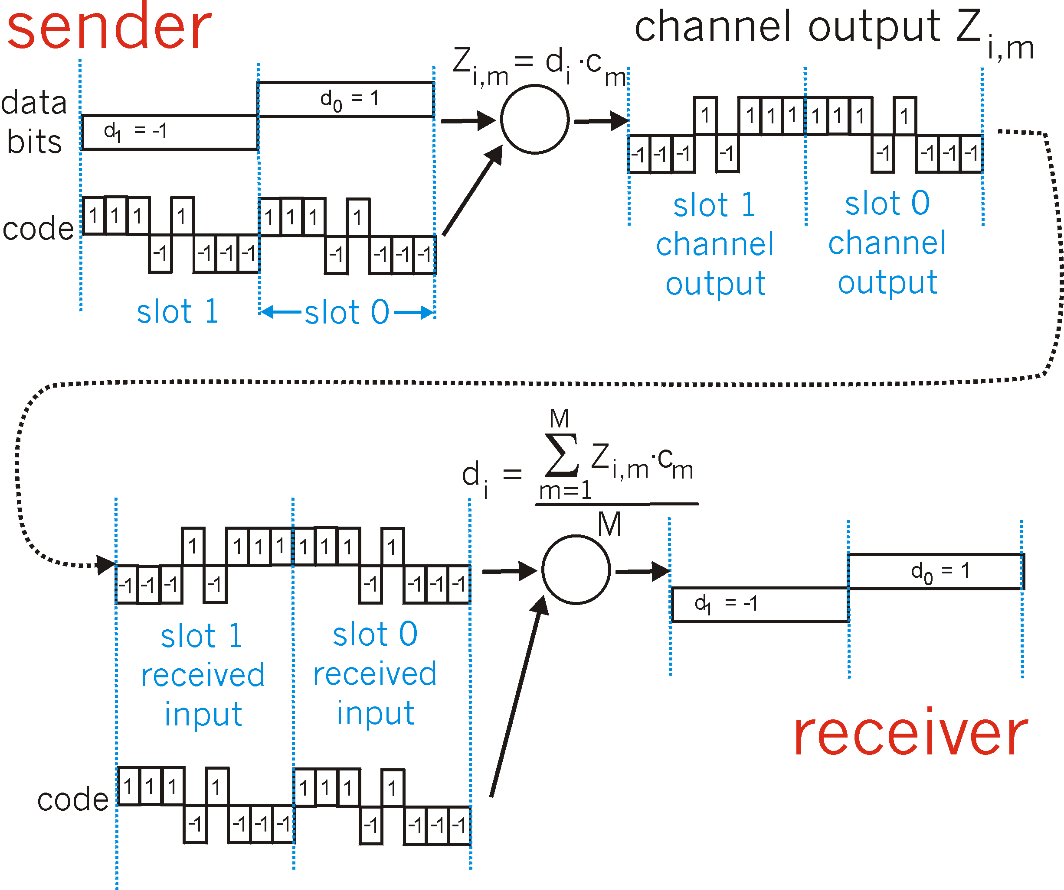
CDMA Encode/Decode

Slide 41

CDMA: Two-sender Interference

Slide 42
Random Access Protocols
When node has packet to send
  Transmit at full channel data rate R.
  No a priori coordination among nodes
Two or more transmitting nodes → “collision”,
Random access MAC protocol specifies:
  How to detect collisions
  How to recover from collisions (e.g., via delayed retransmissions)
Examples of random access MAC protocols:
  Slotted ALOHA
  ALOHA
  CSMA and CSMA/CD

Slide 43

Slotted Aloha
Time is divided into equal size slots (= pkt trans. time)
Node with new arriving pkt: transmit at beginning of next slot
If collision: retransmit pkt in future slots with probability p, until successful.
Success (S), Collision (C), Empty (E) slots

Slide 44

Pure (unslotted) ALOHA
Unslotted Aloha: simpler, no synchronization
Packet needs transmission:
  Send without awaiting for beginning of slot
Collision probability increases:
  Packet sent at t₀ collide with other pkts sent in [t₀-1, t₀+1]

Slide 45
“Taking Turns” MAC protocols
Channel partitioning MAC protocols:
  Share channel efficiently at high load
  Inefficient at low load: delay in channel access, 1/N bandwidth allocated even if only 1 active node!
Random access MAC protocols
  Efficient at low load: single node can fully utilize channel
  High load: collision overhead
“Taking turns” protocols
  Look for best of both worlds!

Slide 46
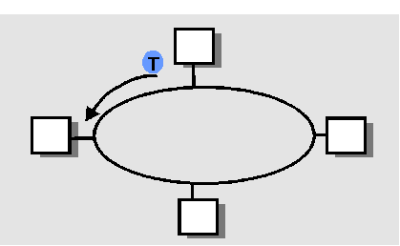
“Taking Turns” MAC Protocols
Polling
Master node “invites” slave nodes to transmit in turn
Request to Send, Clear to Send msgs
Concerns:
  Polling overhead
  Latency
  Single point of failure (master)
Token passing
Control token passed from one node to next sequentially
Concerns:
  Token overhead
  Latency
  Single point of failure (token)

